Slide 1

A Data Scientist and a Threat Hunter Walk into a Bar

Slide 2

Whoarewe.exe
John Dwyer
Angus Chen
Binary Defense ARC Labs
Cybersecurity dude who has done stuff. Connect with John on LinkedIn or Twitter @_dwyer_.
Data scientist with expertise in machine learning for security. Find Angus on LinkedIn or Twitter @chentail.
Explore more about our work at Binary Defense ArcLabs.

Slide 3




The Partnership: Data Scientist and Threat Hunter
Collaboration
Threat intelligence meets machine learning, creating a powerful synergy for advanced threat detection.
Challenges
Considerations on common mistakes and issues that will arise as you get started
Success Story
Case study on kicking starting your journey with ML based threat hunting
Notes:
"Our journey began when Angus and I realized the synergy between threat intelligence and machine learning. By working closely together, we uncovered some amazing results early on, such as detecting a red team operating in a client’s environment. However, it wasn’t all smooth sailing. We encountered challenges around data quality and model explainability, but open communication was the key to overcoming those hurdles."

Slide 4

Intro to Machine Learning
Supervised Learning
Unsupervised Learning
Models trained on labeled data to make predictions or classifications.
Algorithms that find patterns in unlabeled data, useful for anomaly detection.
Reinforcement Learning
Popular ML Models
Models learn optimal actions through trial and error in dynamic environments.
Decision trees, neural networks, and support vector machines for various applications.

Slide 5

Current State of the Hunt
1
Structured Threat Hunting
Hypothesis-driven approach focusing on adversary TTPs. Requires specific knowledge of attack patterns.
2
Asset Driven Threat Hunting
Threat model driven approach. Focuses on protecting critical assets within an organization.
3
Unstructured Threat Hunting
Data-driven approach analyzing large datasets for anomalies. Ideal candidate for ML integration.
Notes:
Talk about different hunt strategies and which have the best applications of ML

Slide 6

Why Threat Hunters Need to Embrace ML
1
Expanding Networks
As networks grow, security teams must process exponentially more data. ML can help manage this scale.
2
Commoditized Threat Landscape
Cybercrime has coalesced around the same goals, objectives, and tactics
3
Maximize human and machine performance
Leveraging ML technology amplifies human capabilities and vice versa, leading to more effective threat detection.

Slide 7

Driving with threat intelligence
Relevant Threat Identification
Ransomware
Ransomware
Adversary Operations
> 90% involve new services
60% use scheduled tasks
Anomaly detection in Image Path
Pattern recognition in task actions
ML Strategy
Notes:
Talk about the importance of a threat driven approach. This is often the beginning stages of a structured threat hunting but it’s extremely valuable when you consider starting with ML. Give yourself an opportunity to work on high value data sets.
"We found several key applications for ML in threat hunting. One notable example is identifying new services or scheduled tasks, which are often linked to suspicious activity. ML can detect patterns in these events, helping identify adversary operations.
By focusing on these high-value data points, we were able to create more precise threat detection models."

Slide 8


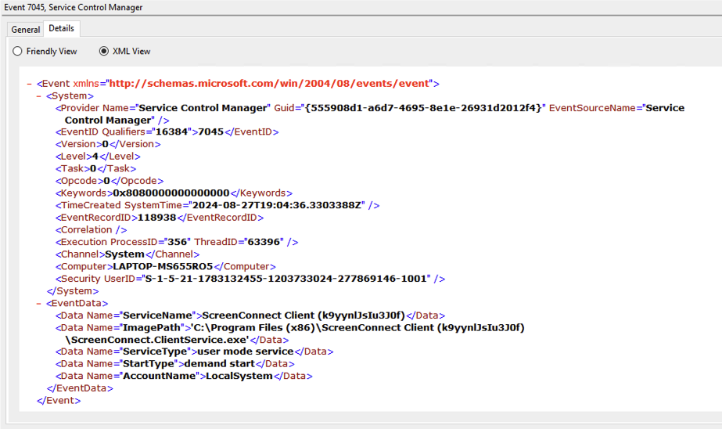


Applying ML to Windows Event Logs
Well-Structured Data
Windows Event Logs provide structured, well-defined data
that is standardized across all Windows systems
making it ideal for ML analysis.
Key Events
New services are captured by the Windows Event Log
by default, where the unique service information is stored
within independent fields
ML Advantages
Machine learning excels at processing
high volumes of log data to identify anomalies.
Notes:
Once you have identified high value data, it’s important you consider the quality of your data and where ML can really help
"Windows Event Logs are a goldmine for structured, well-defined data, making them perfect for ML analysis. Key events such as service creation are captured by default, and we can leverage ML to process these logs at scale, identifying anomalies that may indicate malicious activity.
The structured nature of event logs makes it easy for ML to work its magic."

Slide 9

Case Study: ML for Service Creation
1
Data Collection
Gathering high-quality, relevant security data is crucial for effective ML models.
2
Feature Engineering
Identifying key indicators of compromise to train ML models for threat detection.
3
Model Selection
Choosing appropriate algorithms like Random Forests or Neural Networks for specific use cases.
4
Training and Validation
Rigorous testing ensures model accuracy and prevents overfitting in threat detection scenarios.

Slide 10
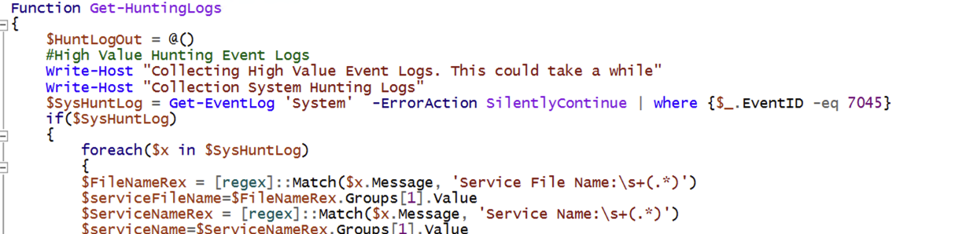
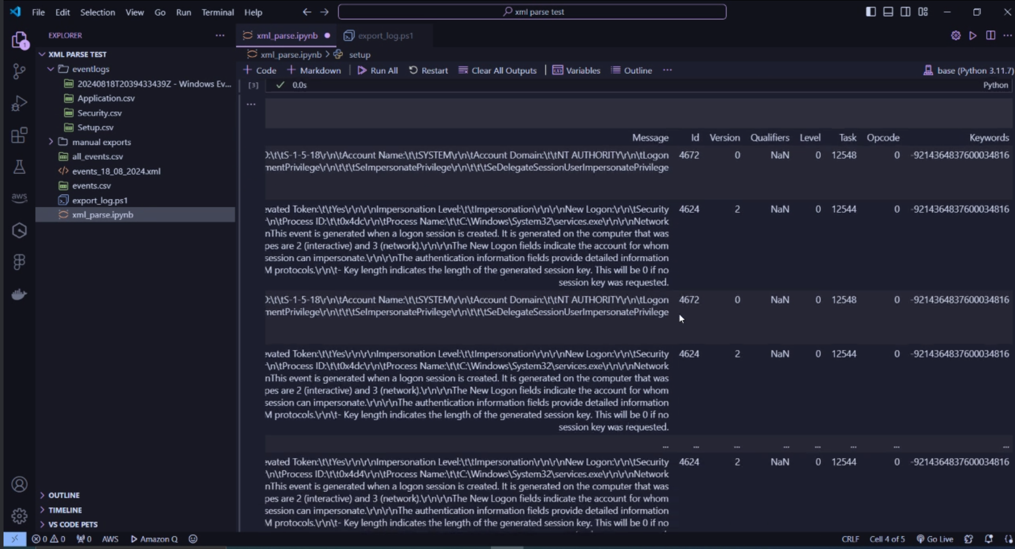
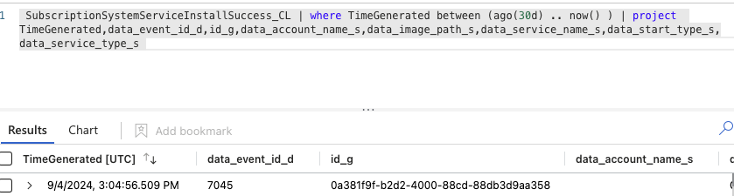
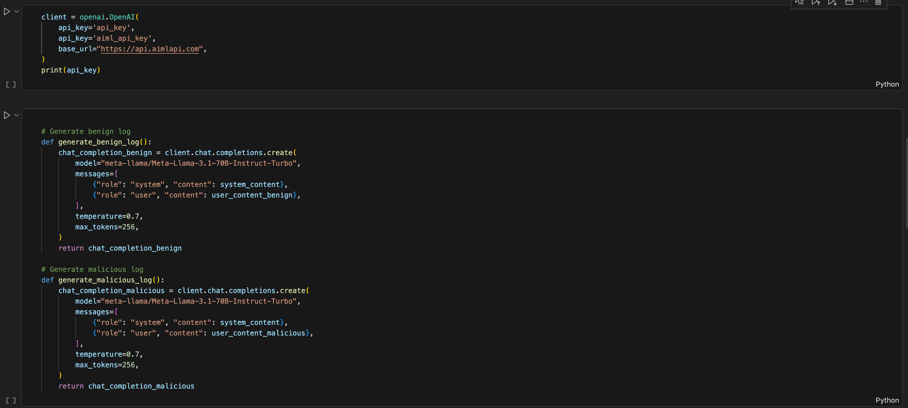
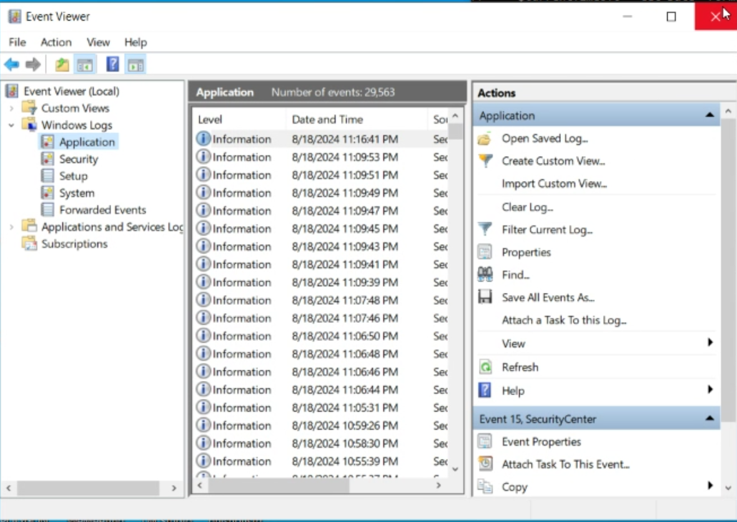
Data Collection
PowerShell- Built-in cmdlets get-eventlog/get-winevent allow you to query and export event logs. Requires some formatting and refinement to properly parse the message field.
Python – python-evtx library can parse .evtx files and enable programmatic access to the event log entries
SIEM – Centralized Windows Event Logs in a SIEM makes it easy to query and export event logs into a structured format
LLM - Large language models provide a great alternative to generate simulated Windows Event Log data
Considerations – Take care when collecting data from multiple sources. While formatting may be easy for a human to understand, it can often cause problems for machines (time stamps, special characters, text encoding, etc.)
index=<your_index> sourcetype IN (“NewServiceInstallSuccess”, “SystemServiceInstallSuccess”)
| where _time >= relative_time(now(), “-13d@d”) AND _time <= relative_time(now(), “-2h@h”)
| where event_id = 7045
4
Notes:
Talk about various easy ways to collect windows event log data without additional investment. Also talk about the considerations you need to make when exporting data so it’s best suited to be analyzed by a machine.

Slide 11
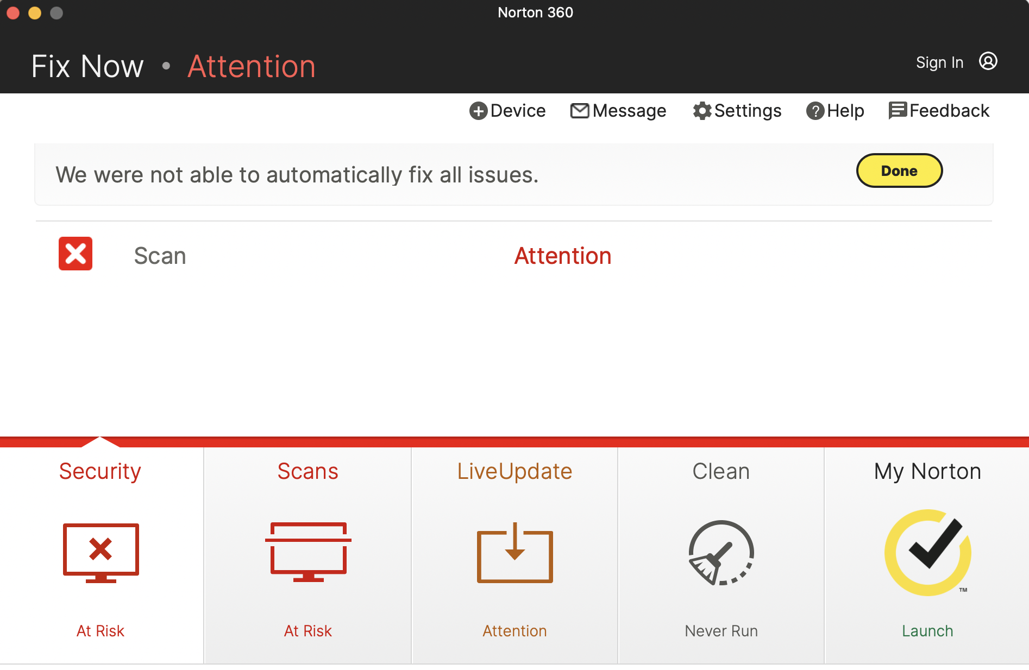
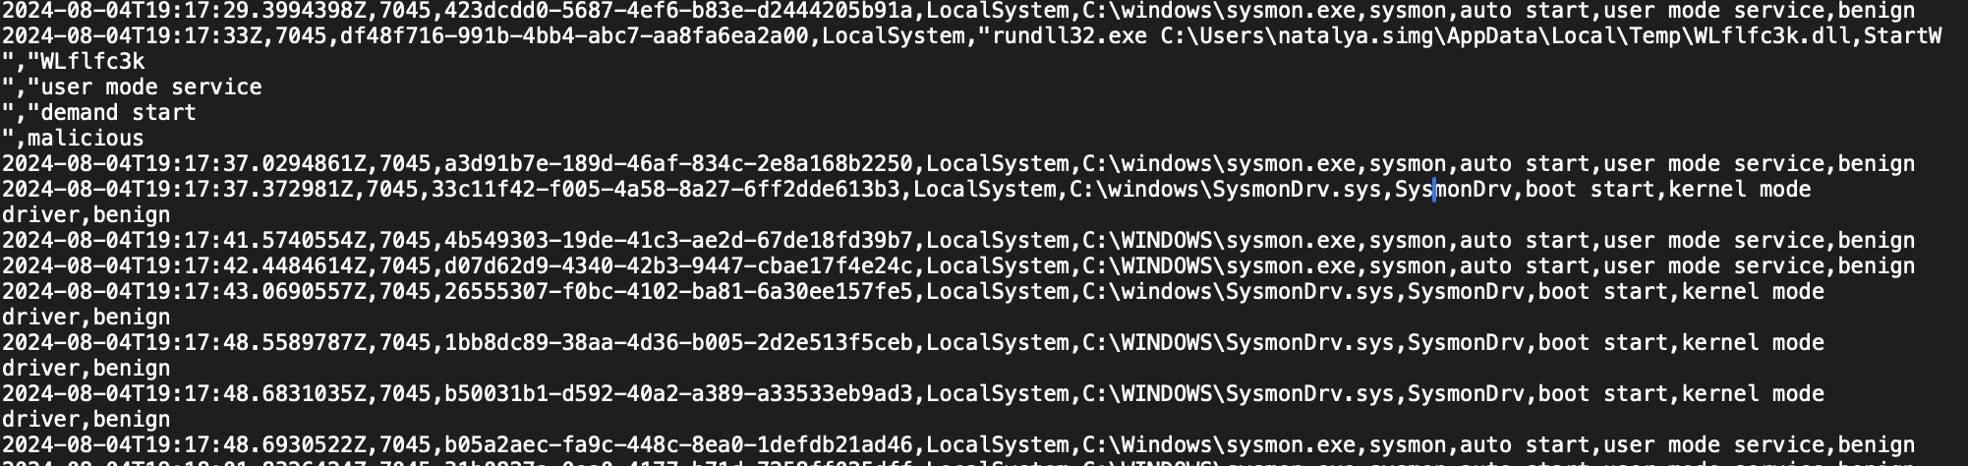
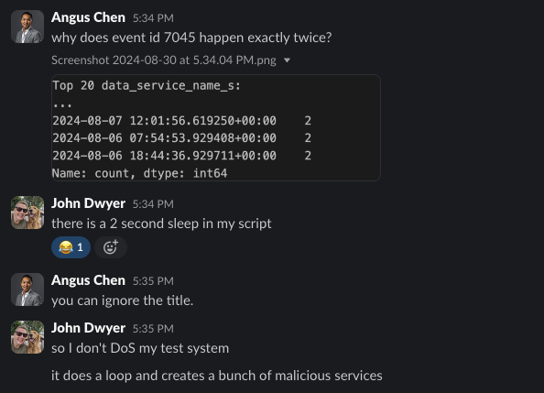
Data Processing
Base64 deco & convert into Hex

Slide 12
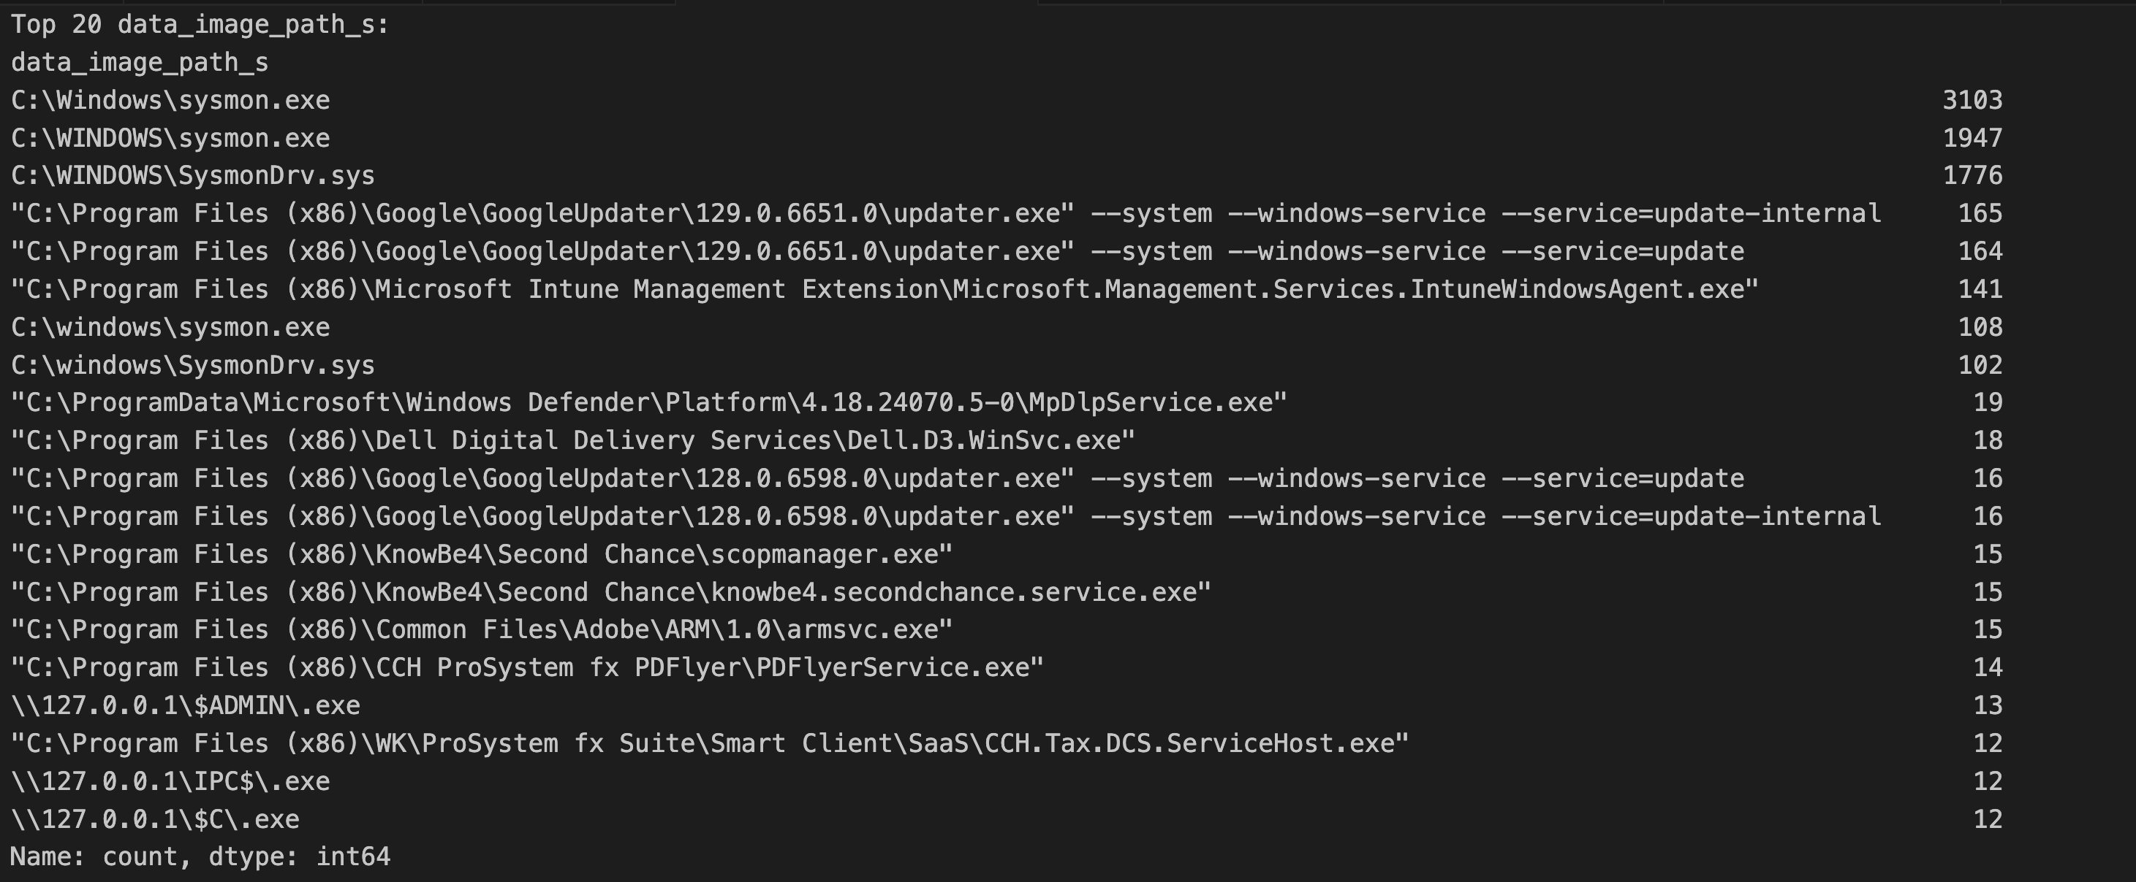
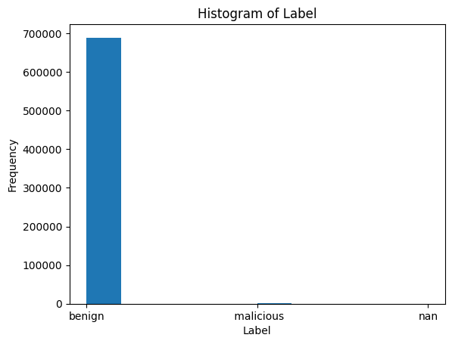
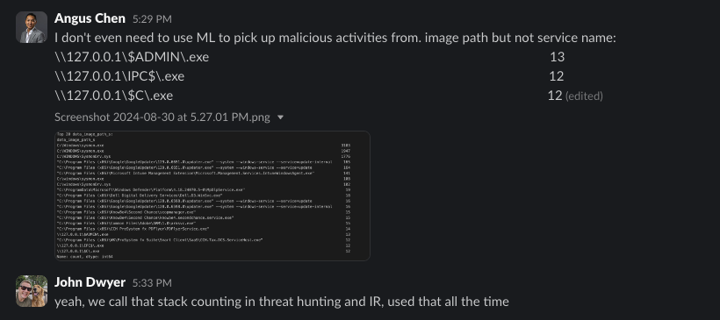

Exploratory Data Analysis
Long Tail Analysis

Slide 13
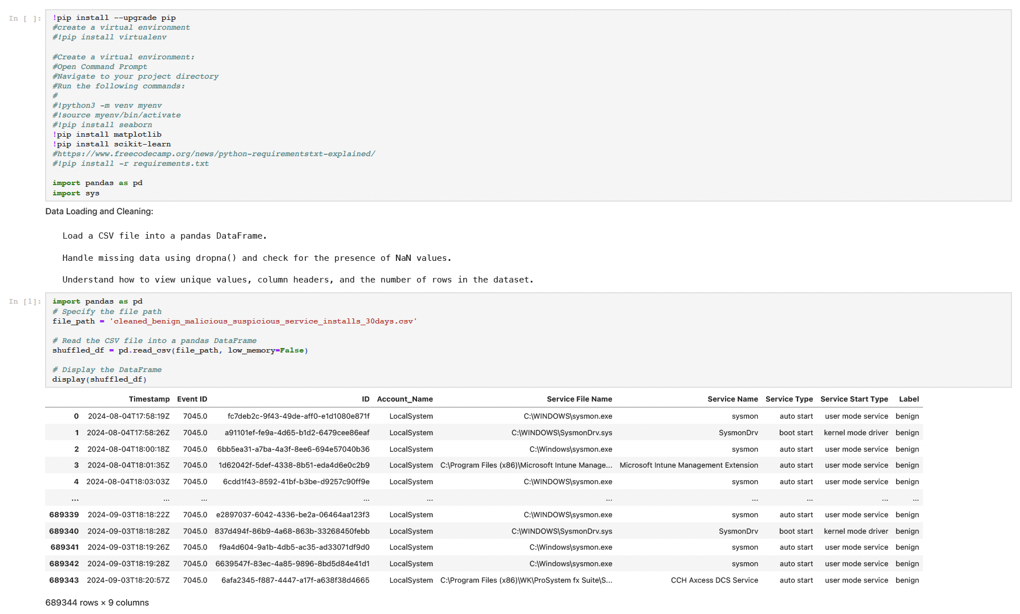
Data Processing

Slide 14
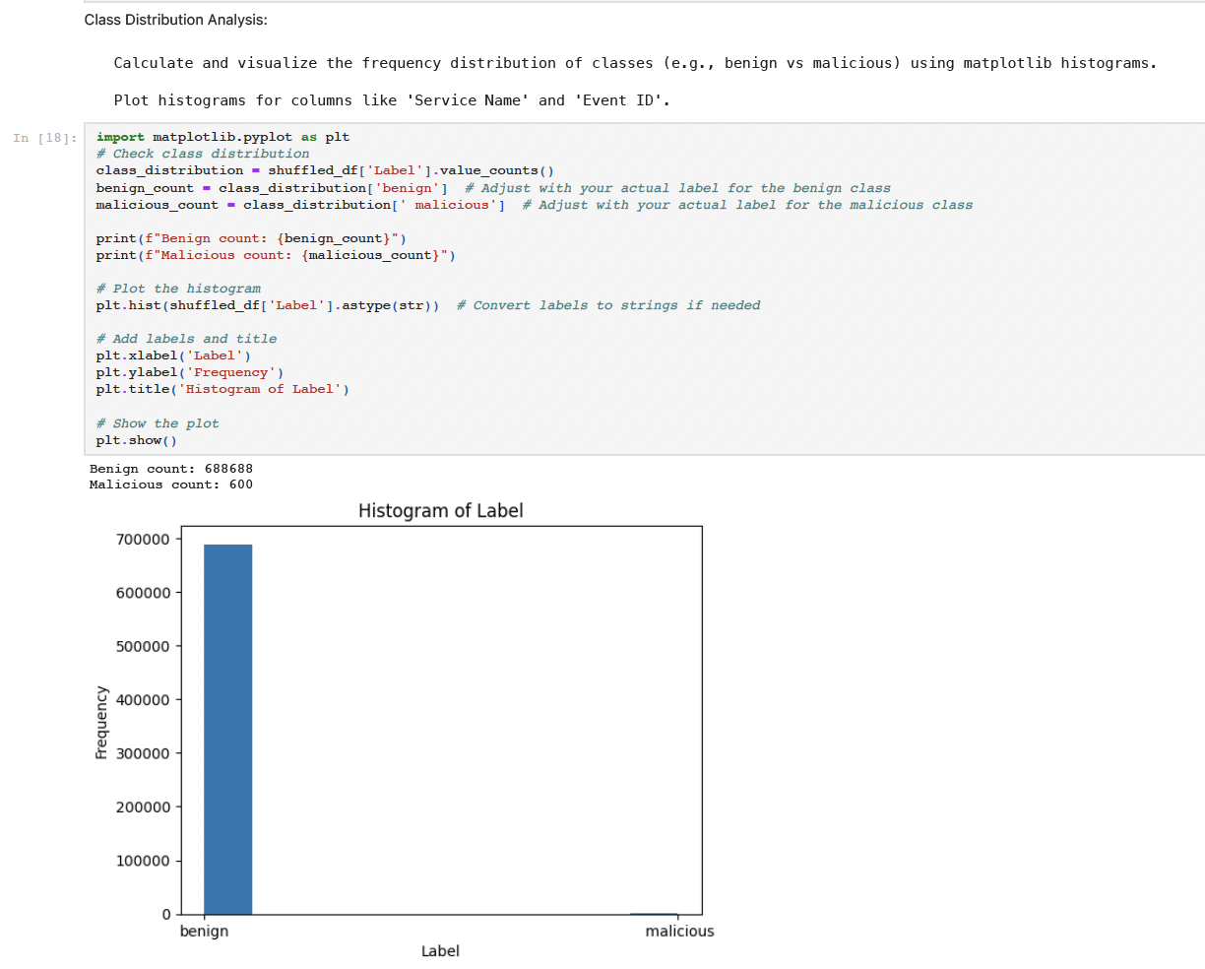
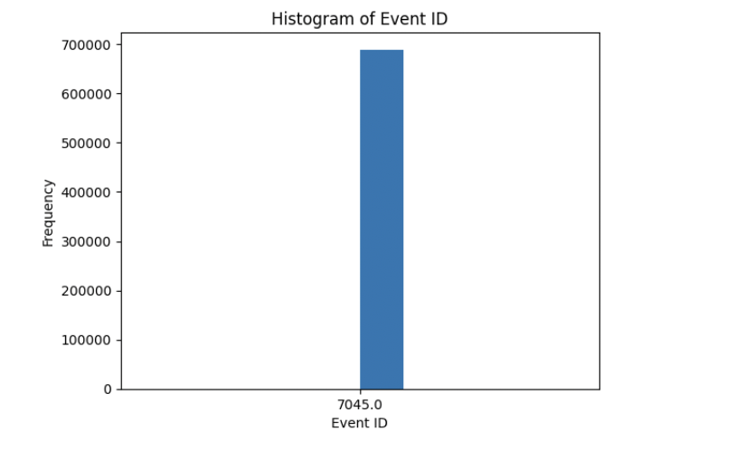
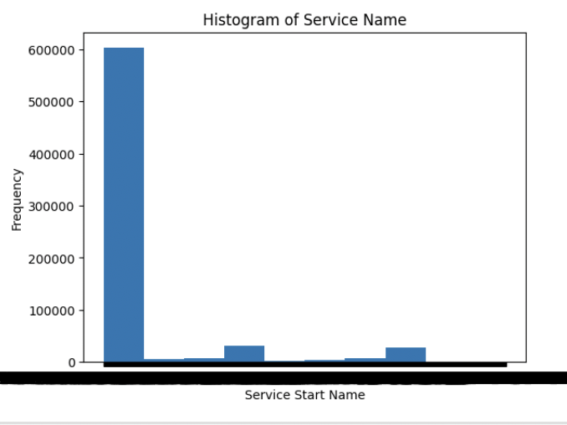
Exploratory Analysis

Slide 15
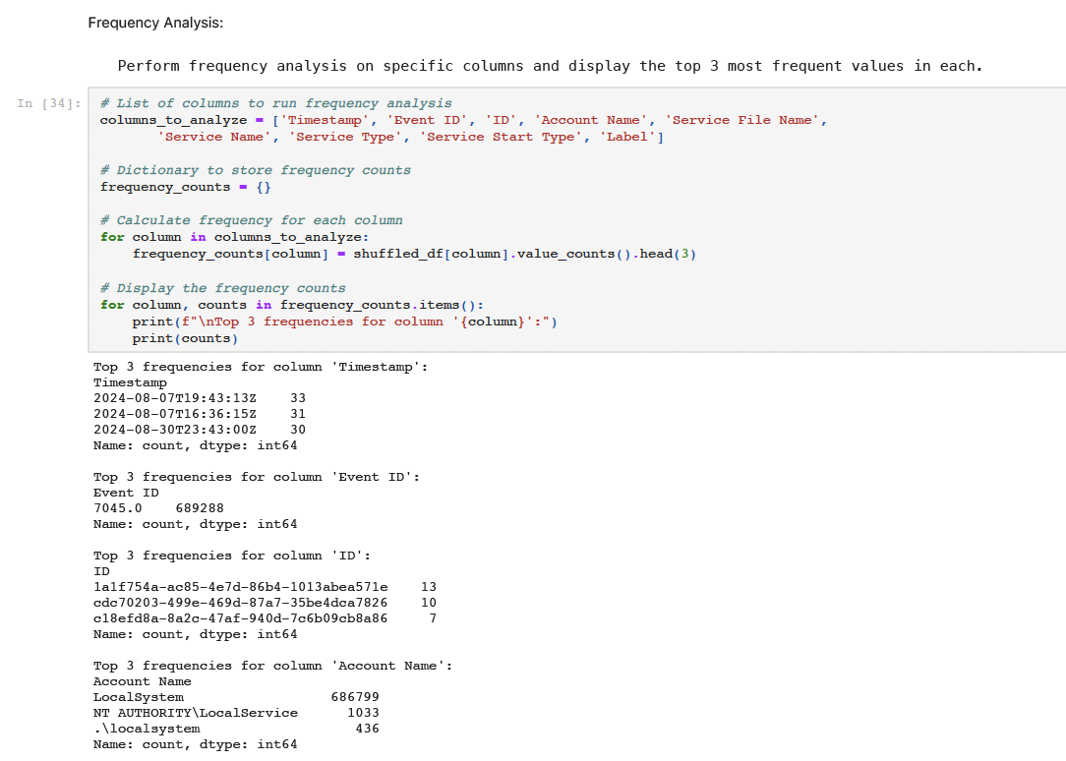
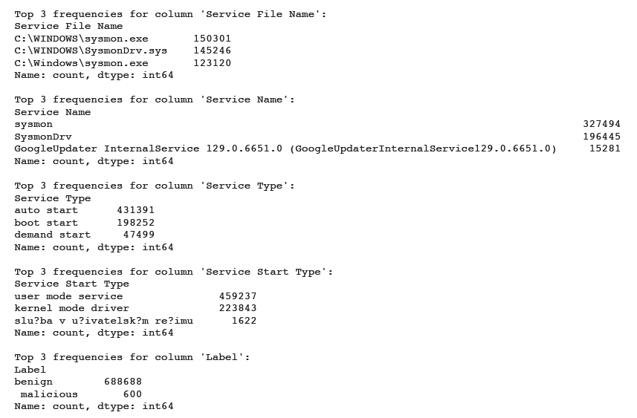
Exploratory Data Analysis

Slide 16
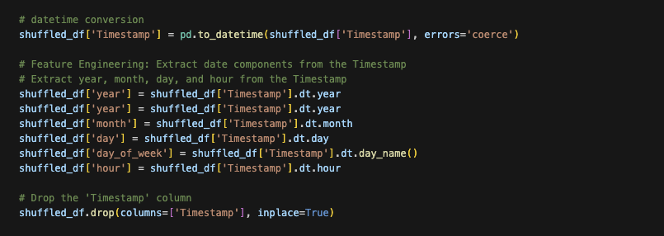
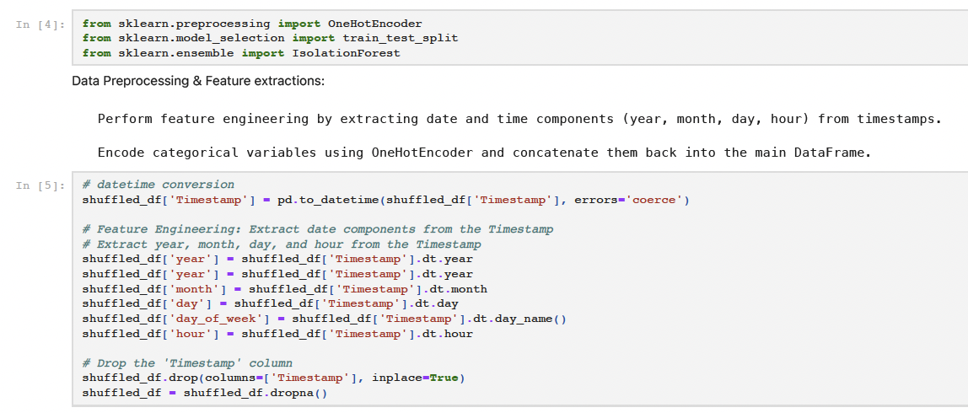
Feature Engineering: Extraction/Selection

Slide 17
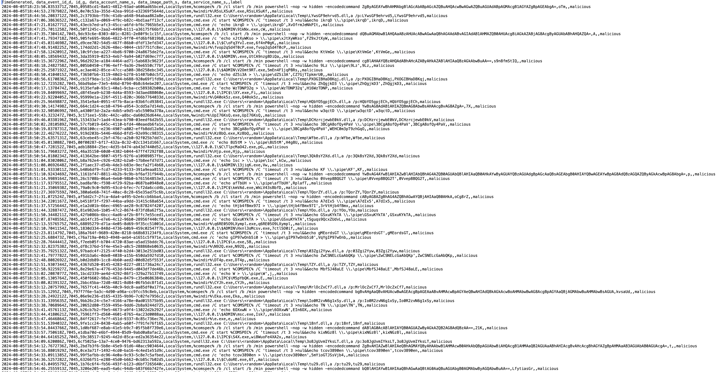
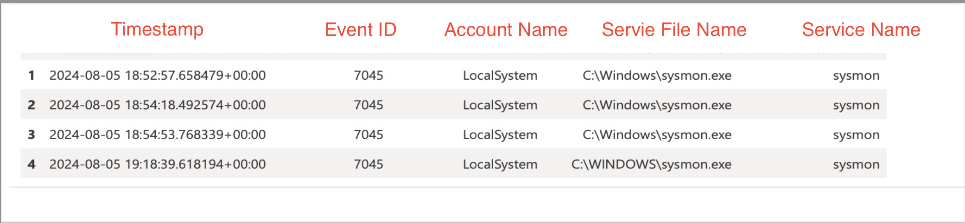
Model Selection
What features are important to our data?
Why are these features important to our data?
How can we best model our data?
AI expects data to be a matrix
Security data is an irregular structure
Events in security data may not be independent
4

Slide 18
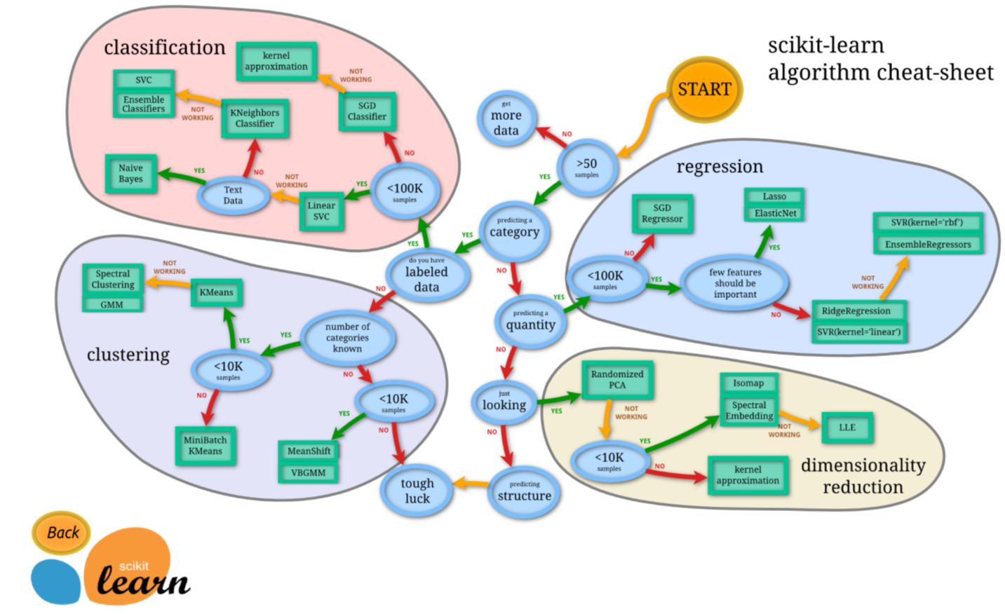
Model Selection
ML System
ML when Output is:
Number
Discrete
Class
Probability
LLM when Output is :
Natural language
Image
Audio
Input
Isolation Forest is an unsupervised machine learning algorithm for anomaly detection. This algorithm leverages an ensemble of decision trees, much like a random forest, to make its predictions. By averaging the results from multiple trees, Isolation Forest assigns a robust anomaly score to each data point, ensuring a more reliable detection of outliers.
Source: F. T. Liu, K. M. Ting and Z. -H. Zhou, "Isolation Forest," 2008 Eighth IEEE International Conference on Data Mining, Pisa, Italy, 2008, pp. 413-422, doi: 10.1109/ICDM.2008.17.

Slide 19
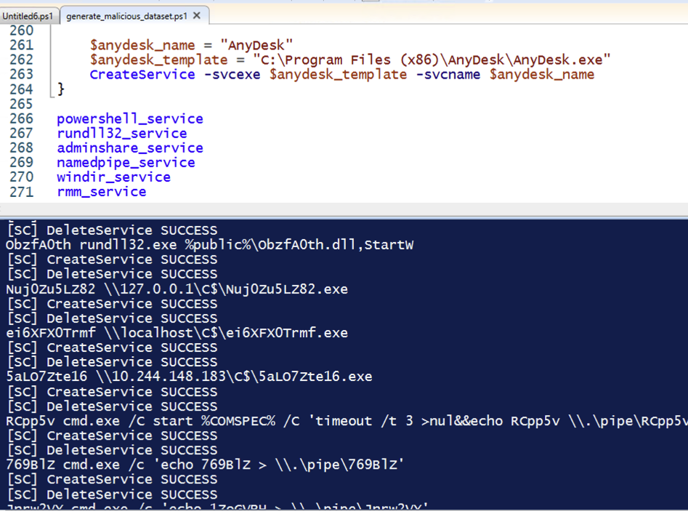
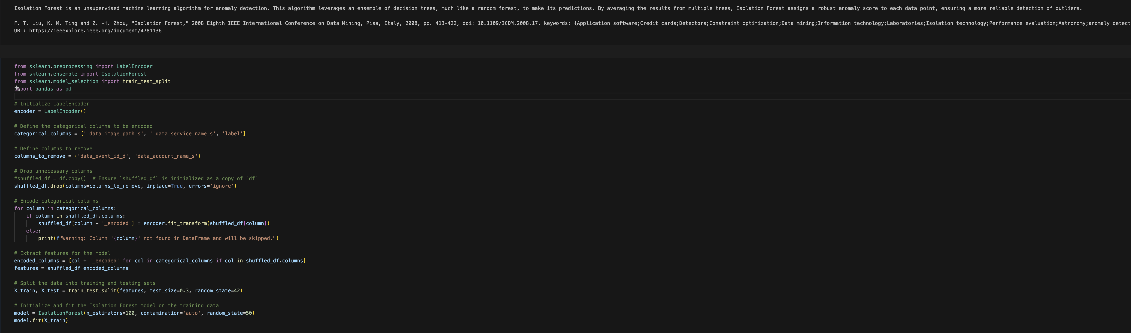
Training and Validation
Data Quality Drives Model Accuracy: High-quality, relevant, and clean data ensures that the machine learning model can accurately detect anomalies and threats in a cybersecurity context.
Representative Data Ensures Coverage: The training data should represent a wide range of real-world scenarios and attack patterns, ensuring the model can generalize well and detect both known and emerging threats.
Balanced Data Prevents Bias: Balanced training data helps avoid overfitting or bias toward certain types of threats, ensuring the model can effectively identify a diverse set of malicious activities.
(80/20,70/30 good starting ratios for supervised learning)
Continuous Data Updates Improve Detection: Regularly updating training data with new threat intelligence and evolving attack techniques allows the model to stay current and improve its ability to detect the latest cyber threats.
4
Notes:
For your ML models to be successful you need to feed it training data. There are various ways you can obtain training data and we’re gonna give one away today for you to get started. However you must put the time in to make sure that you are properly formatting your training data so it meets the same quality as your normal data collection.

Slide 20
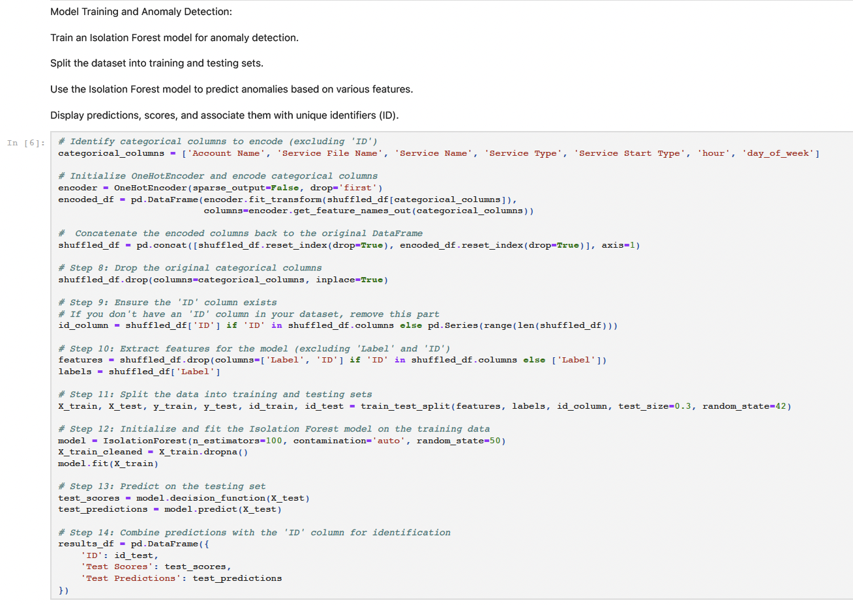
Model Training

Slide 21
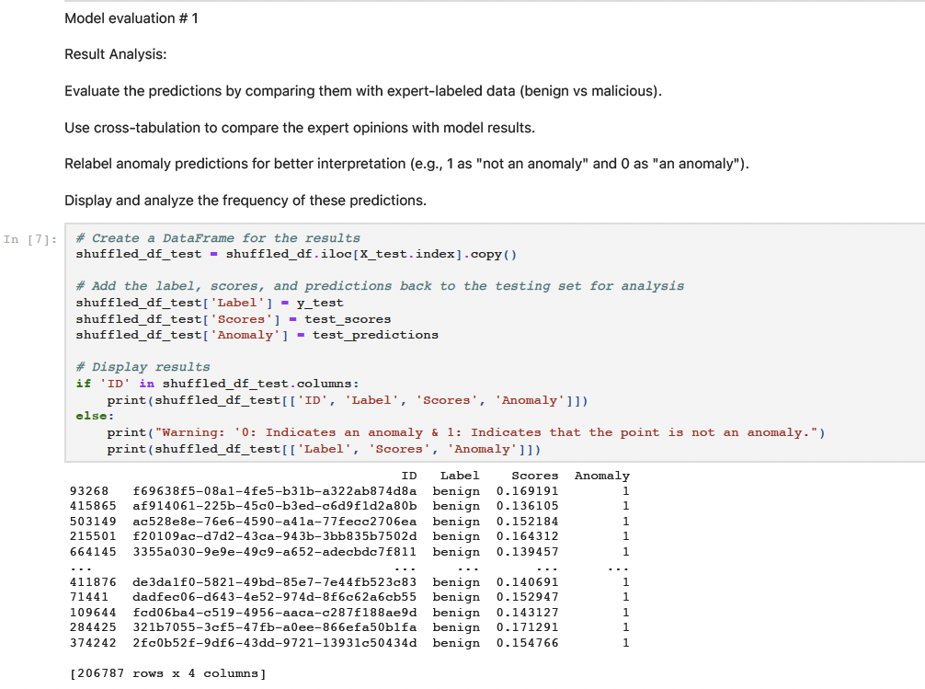
Model Training

Slide 22
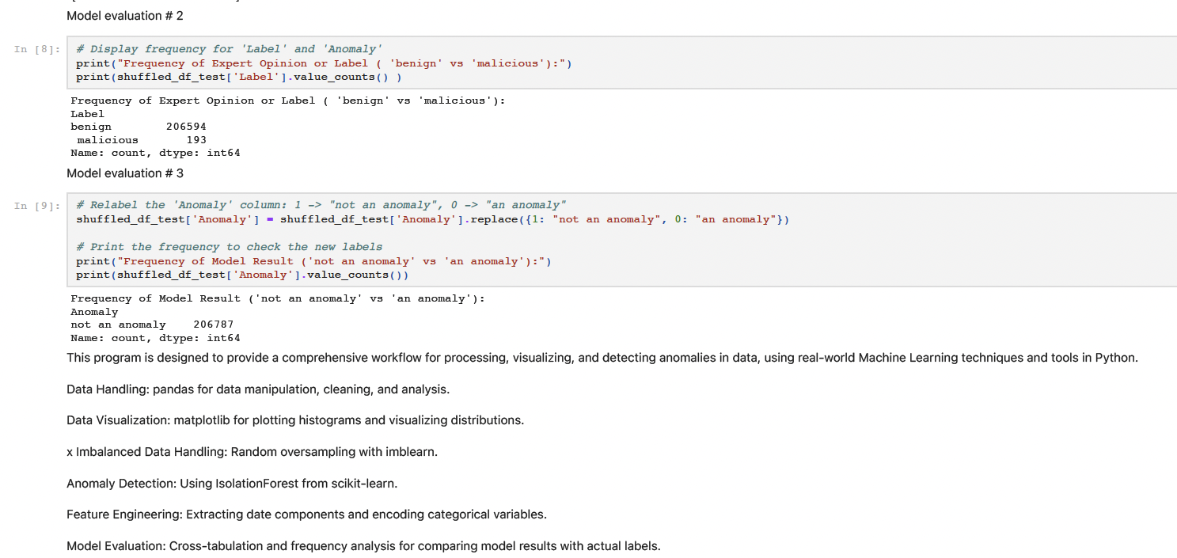
Model Validation

Slide 23
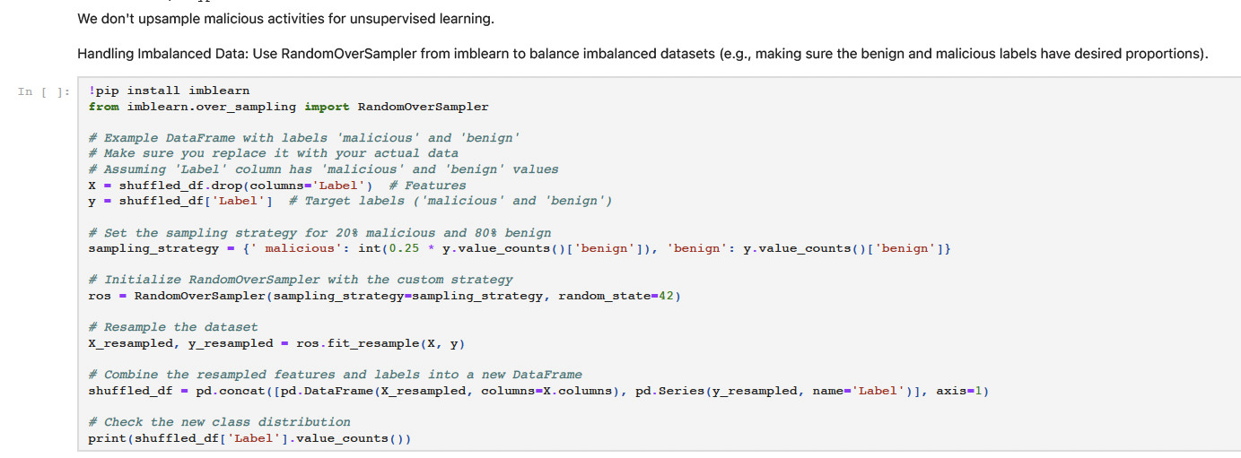
Model Evaluation
Accuracy is 100%! What’s Happening?
Adjust the Ratio of Benign and Malicious Data:
A perfect accuracy score can be misleading, especially if the dataset is imbalanced.
Consider Using Supervised Learning:
While Isolation Forest is an unsupervised method, switching to a supervised learning algorithm might yield better performance if you have labeled data. Supervised models can leverage the labels to make more informed decisions about the data.
Experiment with Different Models:
Don’t rely solely on one model. Try other anomaly detection techniques to compare results and verify the robustness of the findings.
Train-Test Split May Not Be Critical:
Since Isolation Forest is unsupervised, the train-test split might not play a significant role in model performance. However, always ensure that the data is split appropriately for supervised learning models if you choose that route.
Enhance the Dataset with Additional Features:
Adding more features or incorporating additional datasets for enrichment can give the model more context and improve its ability to detect anomalies. This can help reduce overfitting and improve generalization.

Slide 24
Take it to the next levels
Trends and future directions in integrating ML with threat hunting.
Identifying other data sources for ML
GitHub repo to play with this example
https://github.com/BinaryDefense/ARC-Labs-ML-Starter-Kit

Slide 25
Back Ups

Slide 26
Case Study: ML for Service Creation
Data Collection
Preprocessing
Feature Engineering
Model Traning,
Validation
& Evaluation
PowerShell scripts to generate and extract relevant Windows Event Logs for model training.
Event Viewer
LLM
KQL
Cleaning and structuring log data prepares it for ML model training.
Low variance
Extracting key indicators from service creation events enhances model accuracy.
Time Stamp
Unsupervised learning
Isolation forest

Slide 27
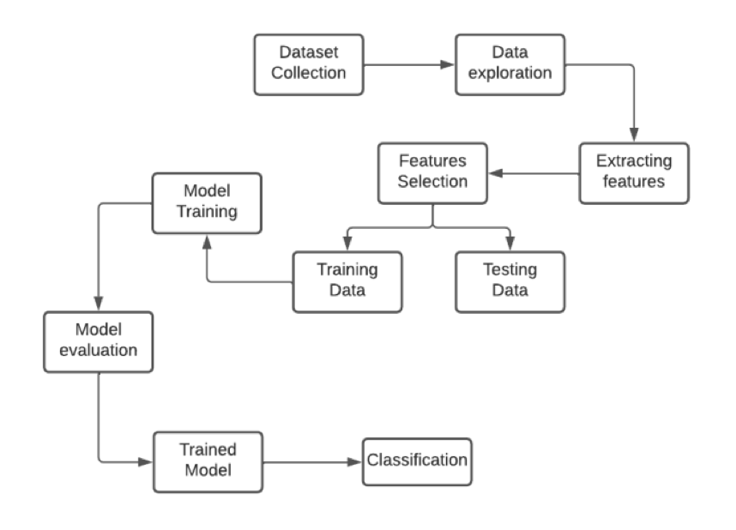
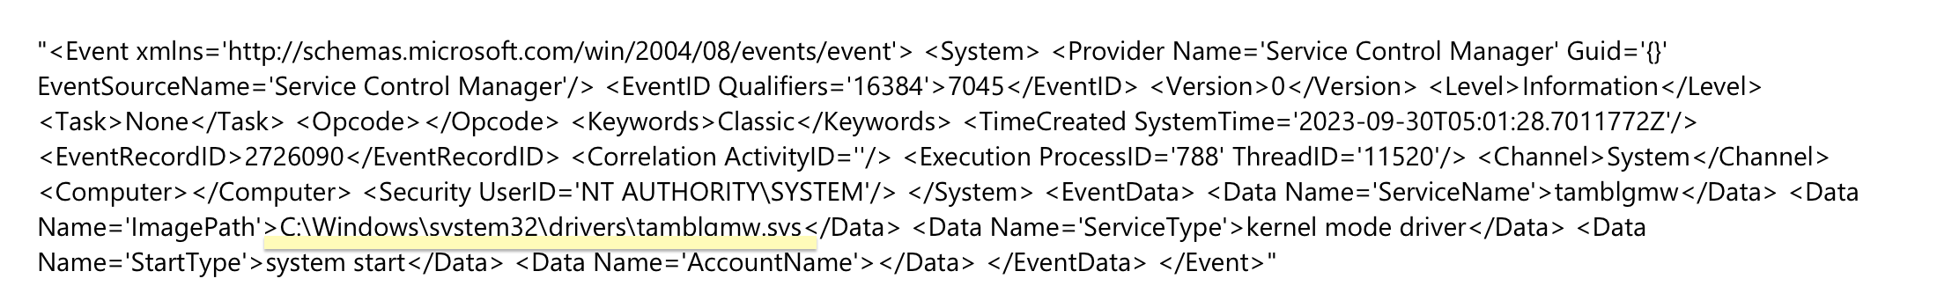
Data Collection: Event Viewer

Slide 28
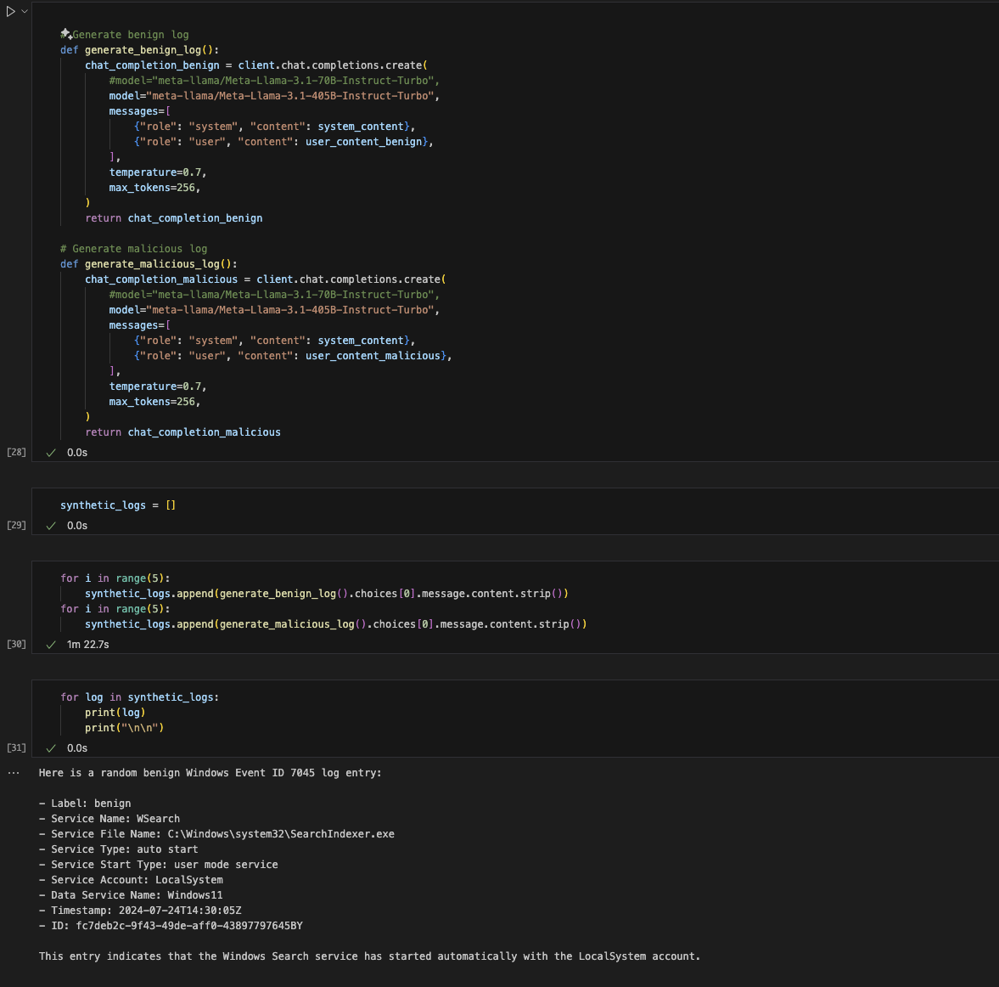
Data Collection: LLM & SIEM
Llama3.1
Query Language
index=<your_index> sourcetype IN (“NewServiceInstallSuccess”, “SystemServiceInstallSuccess”)
| where _time >= relative_time(now(), “-13d@d”) AND _time <= relative_time(now(), “-2h@h”)
| where event_id = 7045
Query Language Output

